Slide 1

Changes are Similar:
Measuring Similarity of Pull Requests that Change the Same Code in GitHub
Ping Ma, Danni Xu, Xin Zhang, and Jifeng Xuan
E-mail: pingma@whu.edu.cn

Slide 2
01
Background and Motivation
02
Measurement Methods
03
Experiment Setup
04
Experiment Results
05
Conclusion
CONTENT

Slide 3
01
Background and Motivation

Slide 4

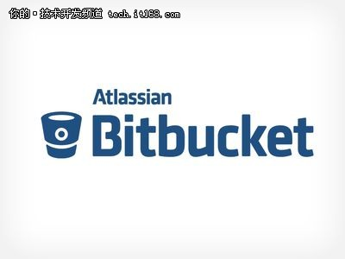
01
Background and Motivation
Collaborative platforms help collaborative work

Slide 5


Background and Motivation
01
The mechanism of collaborative work on github
Project manager
Other developers
Deploy the codebase
Fork the project into their own account

Slide 6
Background and Motivation
01
The mechanism of collaborative work on github
Developer
Project manager
Submit Pull Requests
Make changes to the original project?

Slide 7
Background and Motivation
01
The mechanism of collaborative work on github
Developer
Project manager
Submit Pull Requests
One or more commits
Accept it?
Discard it?
Each of commit contains edit

Slide 8
Background and Motivation
01
Project manager
Merge which one??
Pull Request A
Pull Request D
Pull Request C
Pull Request B
Change the same lines

Slide 9
Background and Motivation
01
Do these pull requests that change the same lines behave similar?
Not Similar
Similar
Directly distinguish the pull requests
A semantical or further detailed analysis

Slide 10
Background and Motivation
01
Do these pull requests that change the same lines behave similar?
A preliminary study on the similarity between pull requests that change overlapped pieces of code.

Slide 11
02
Measurement Methods

Slide 12
02
Measurement methods
The cosine method – for structure similarity
The doc2vec method – for semantic similarity
Treat the pull requests as two pieces of code

Slide 13
02
Measurement methods
The cosine method
Segmentation
Filter out the punctuation inside the code and separate the code into tokens
assertThat
processDefinitions
getBody
getContent
hasSize
4

Slide 14
02
Measurement methods
The cosine method
2. Vectorization
collect the frequency of tokens in two pull requests and obtain the word-frequency vectors

Slide 15

02
Measurement methods
The cosine method
3. Similarity computation
For the given two vectors, leverage the cosine to calculate the similarity.
The closer the cosine is to 1, the more similar two vectors are

Slide 16
02
Measurement methods
The doc2vec method
an unsupervised algorithm that can extract the vector expression of sentences or documents

Slide 17
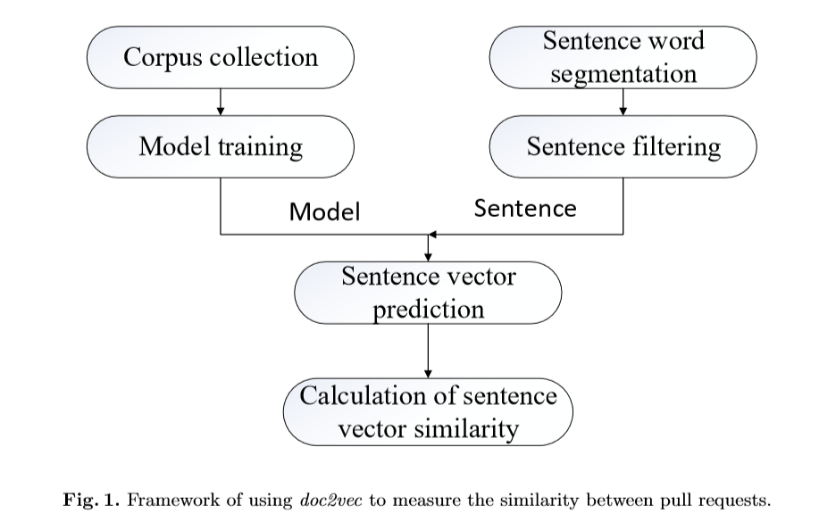
02
Measurement methods
The doc2vec method
1. Model training
extract the source code of a previous version of each project
ﬁlter out the punctuations and use all tokens in these processed source code as a training corpus
employ the doc2vec to build the model with the training corpus

Slide 18
02
Measurement methods
The doc2vec method
2. Pull requests similarity calculating
filter out the sentences whose tokens not inside the training corpus
use the learned model to predict the sentences vectors and use these vectors to calculate the similarity

Slide 19
03
Experiment Setup

Slide 20
03
Experiment setup
Data Preparation
selected the top-5 Java projects with the most forks in GitHub
collect all pull requests that are submitted from January 1st to December 31st, 2017
extracted all pairs of pull requests, which contain changes on overlapped code during the same time period
Notes:
只考虑了前四个项目，，，，，所有的pull requests对都是考虑了同一个文件内的 同一个文件内的多处修改看成一处修改 只考虑了增加代码行的情况

Slide 21
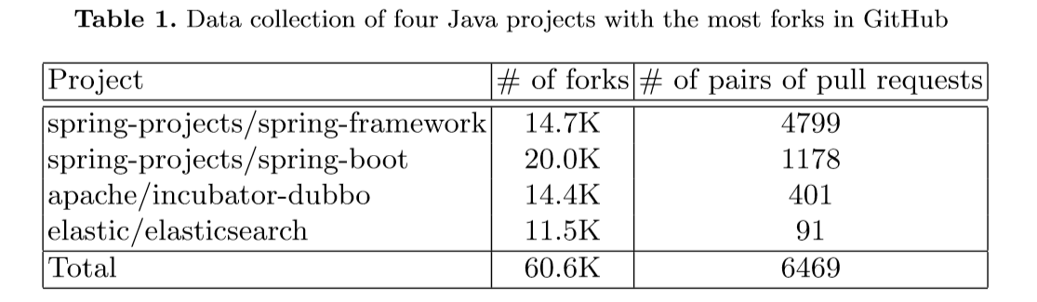
03
Experiment setup
Data Preparation
Notes:
ElasticSearch是一个基于Lucene的搜索服务器。它提供了一个分布式多用户能力的全文搜索引擎，基于RESTful web接口。Elasticsearch是用Java开发的，并作为Apache许可条款下的开放源码发布，是当前流行的企业级搜索引擎。设计用于云计算中，能够达到实时搜索，稳定，可靠，快速，安装使用方便
Apache Dubbo (incubating) is a high-performance, java based, open source RPC framework.

Slide 22
03
Experiment setup
Research Questions
RQ1. How does the similarity between pair of pull requests perform?
RQ2. What is the distribution of the similarity between pair of pull requests?
RQ3. Is there any correlation between the two measurement methods of similarity?

Slide 23
04
Experiment Results

Slide 24
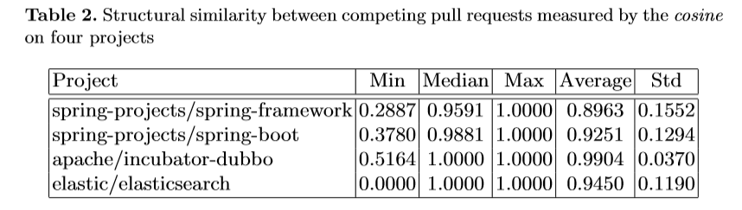
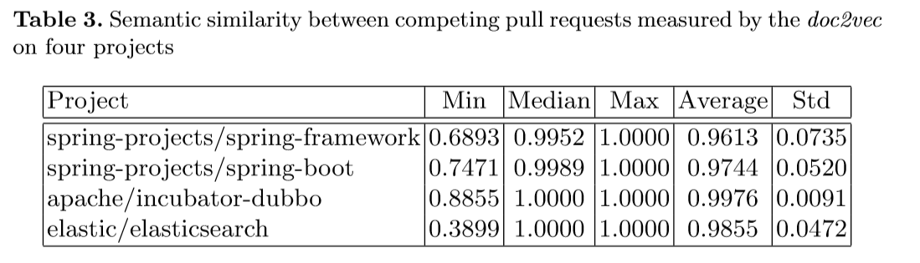
04
Experiment results
RQ1. How does the similarity between pair of pull requests perform?

Slide 25
04
Experiment results
RQ1. How does the similarity between pair of pull requests perform?
The similarity between pull requests is generally high, but there is still low similarity between several pull requests. This results in the diversity of similarities.

Slide 26
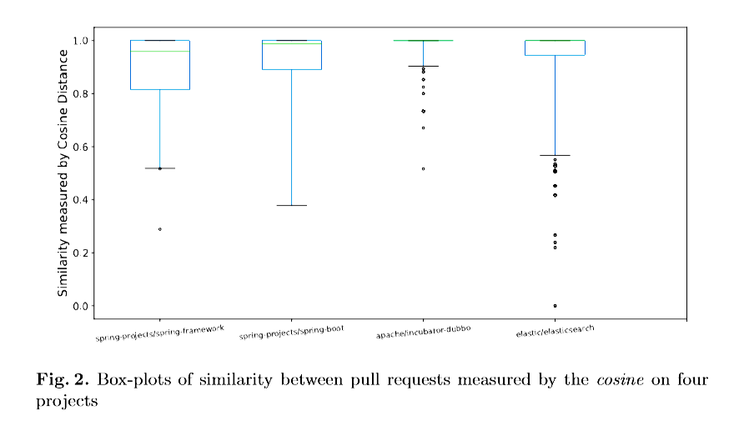
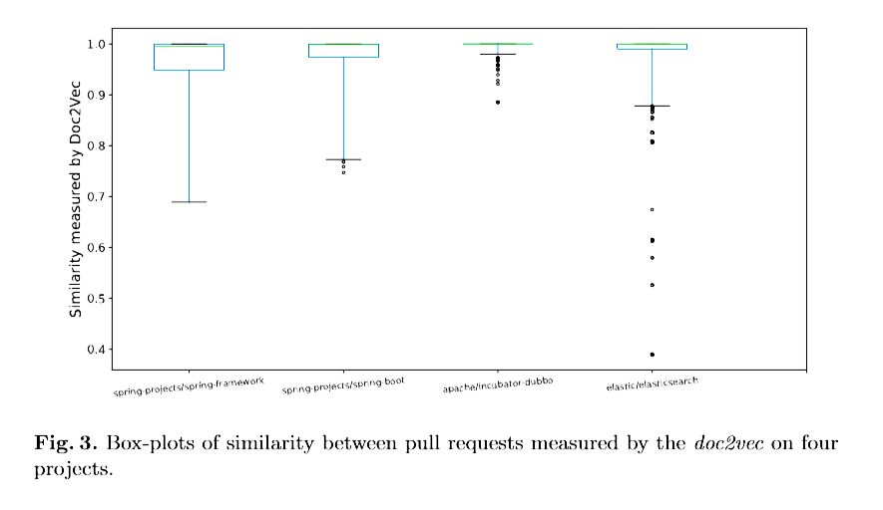
04
Experiment results
RQ2. What is the distribution of the similarity between pair of pull requests?

Slide 27
04
Experiment results
RQ2. What is the distribution of the similarity between pair of pull requests?
The similarity between the majority of pull requests is high

Slide 28
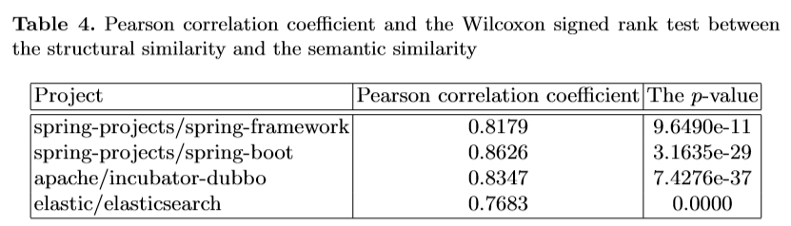
04
Experiment results
RQ3. Is there any correlation between the two measurement methods of similarity?
reach high correlation
behave statistically signiﬁcant diﬀerences

Slide 29
04
Experiment results
RQ3. Is there any correlation between the two measurement methods of similarity?
The result by these two methods is diﬀerent but similar. This fact may indicate the overlap between the structural similarity and the semantic similarity

Slide 30
05
Threats to Validity

Slide 31
05
Threats to validity
Only used 4 open-source Java projects
The corpus that we used may hurt the measurement
Is the detected similarity by the cosine or the doc2vec really similar?

Slide 32
06
Conclusion

Slide 33
05
Conclusion
There indeed exist high similarity between pull requests
There exists shared opinions by two measurement methods, the cosine and the doc2vec

Slide 34
Thanks for Listening
End.

